Slide 1

CAPSTONE PROJECT -1
EXPLORATORY DATA ANALYSIS
(EDA)
ON
GOOGLE PLAY STORE APP REVIEW
Team Members
Asit kumar Panda
Under the Guidance of Team Almabetter

Slide 2
CONTENT
INTRODUCTION
PROBLEM STATEMENT
DATA OVERVIEW
EXPLORATORY DATA ANALYSIS
SUMMARY ANALYSIS

Slide 3
INTRODUCTION OF PLAYSTORE
Google Play Store is an online store for android applications
Games, movies, TV shows, books, and many more categories are available
Their products available to over two billion people
Google Play Store
Available in 190 countries
Safe, secure, and convenient

Slide 4
PROBLEM STATEMENT
Play store is a huge market for android application, so we will perform exploratory data analysis for play store data to get some desired comments on play store such as –
Number of Paid Apps & Free Apps
which category apps are found more on play store
Top categories Apps on Google Play store
Percentage of apps in each category in the play store
Average rating of the apps
Number of installs App's in Google play sore
Top 10 installed apps ?
Top Free apps
From all these points a developer can understand in which region they should work for highest return of investment

Slide 5
DATA OVERVIEW
Play Store Data
This data contains the property and characteristics of each apps
App
Category
Rating
Reviews
Size
Installs
Type
Price
Content rating
Genres
Last updated
Current ver
Android ver
User Reviews
This data includes reviews based on user's personal experience, this can be converted in variable and can be used for analysis
Translated_Reviews
Sentiment
Sentiment_Polarity
Sentiment_subjectivity

Slide 6
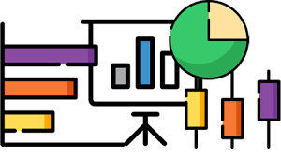
EXPLORATORY DATA ANALYSIS

Slide 7
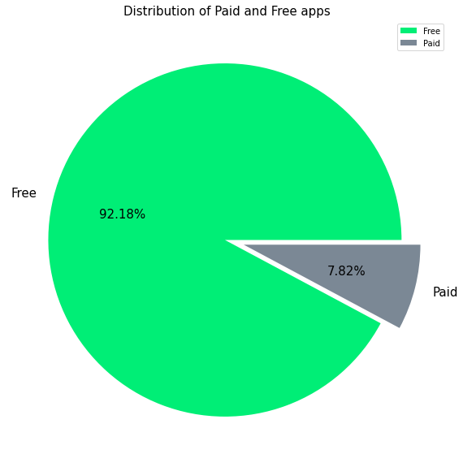
Number of Paid Apps & Free Apps
In this graph we visualize the percentage of free and paid apps. After distribution of all apps from google play store we found 92.18 % of apps available free and 7.82 % of apps found paid version.

Slide 8
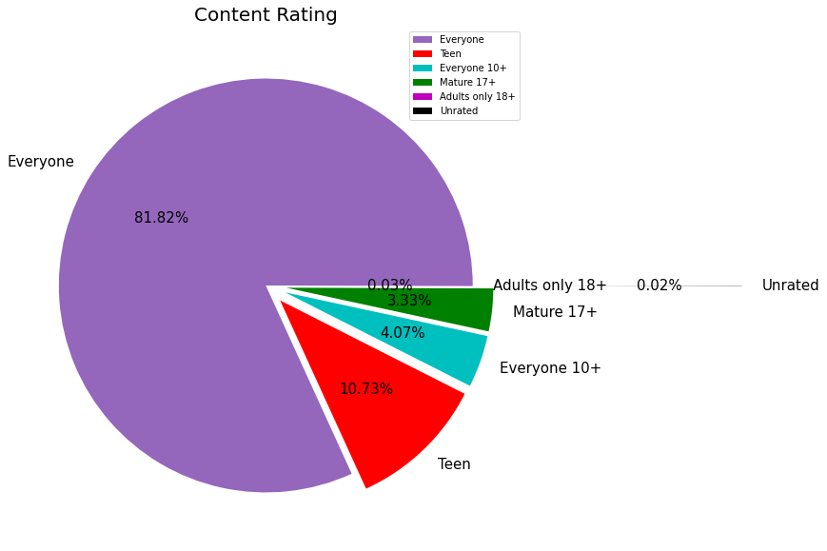
Content Rating category apps
In this observation we visualize which app is more found on play store. We found that Everyone category app is found more in play store with 81.82 %.

Slide 9
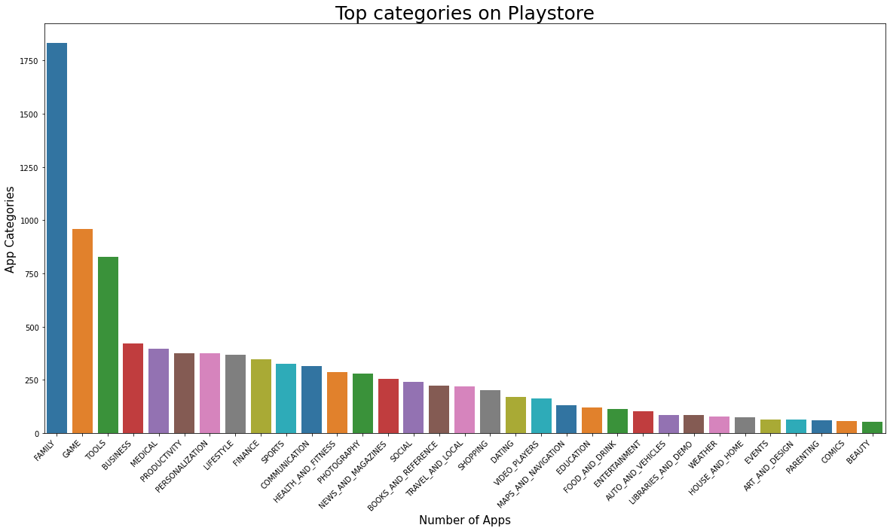
Top categories Apps on Playstore
In this observation we found Family , game and tools apps are top 03 apps on play store.

Slide 10
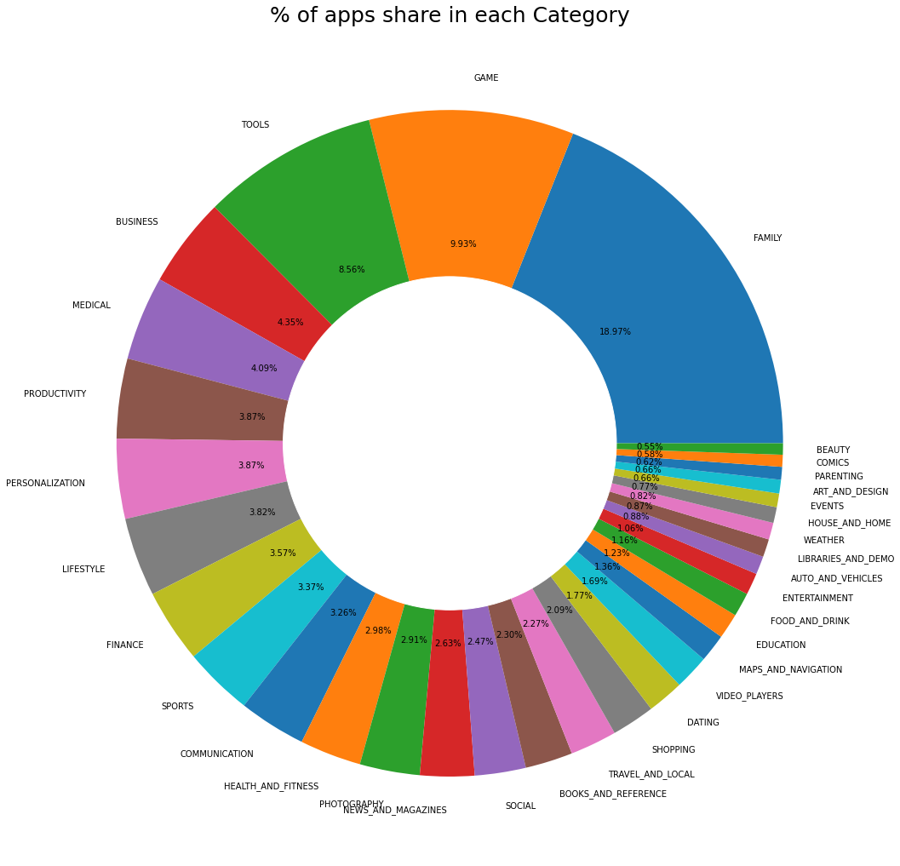
Percentage of apps in each category in the playstore
In this visualization we observe that percentage of apps present on google play store in each category.
Family, Game and tools apps are top 03 apps in play store which having 18.97%, 9.93% and 8.56% respectively.

Slide 11
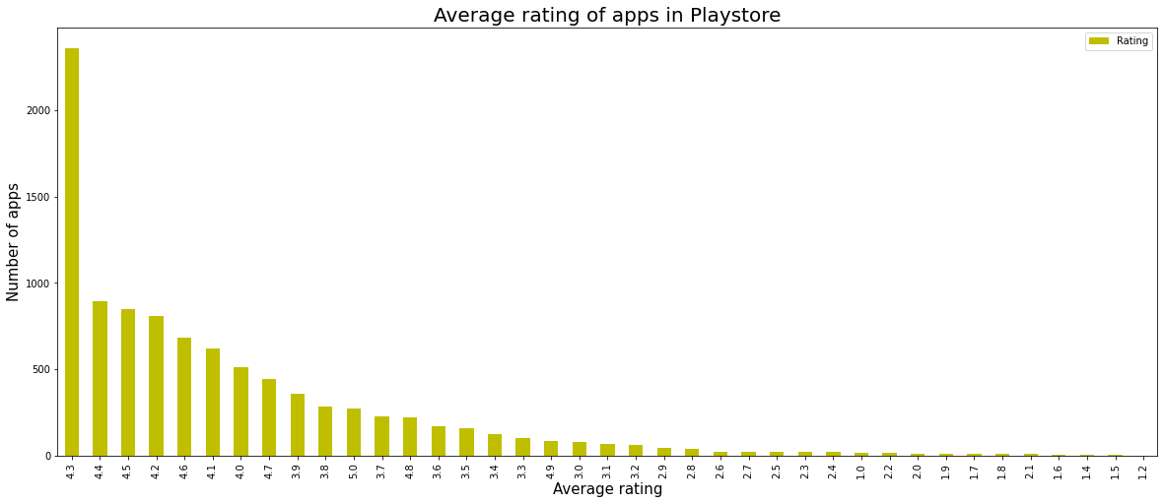
Average rating of the apps
In this visualization we present the average rating of apps , most of the apps getting 4.3 rating from the customer.

Slide 12
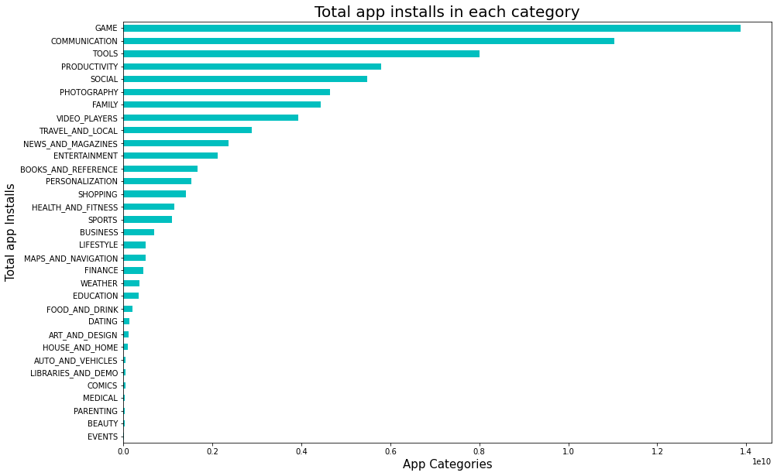
Most number of installs App's in Google playstore
Here we present number of install apps in play store . We found Game, communication and tools app installed most in the google play store by the customer.

Slide 13
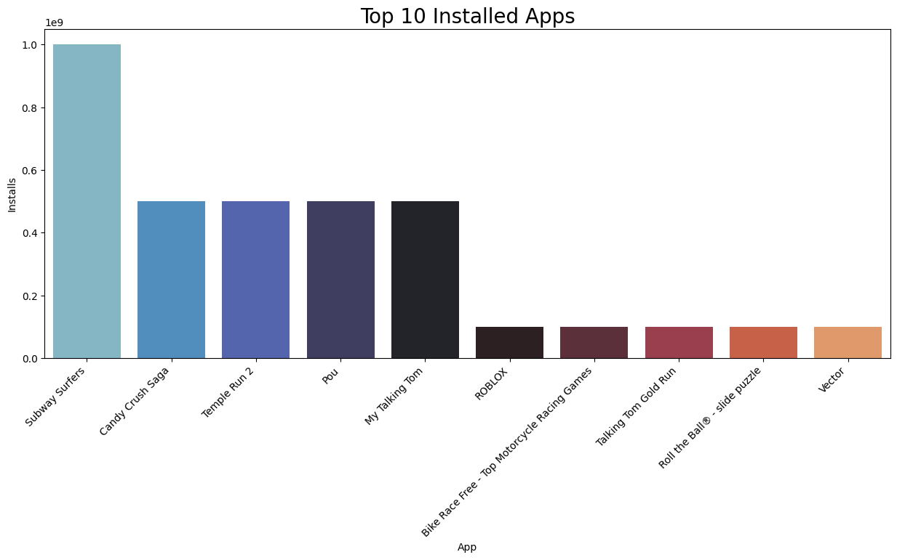
What are the Top 10 installed apps
In this visualization we found the top 10 installed apps from google play store. Subway surfers is the number one installed apps in the play store. After that candy crush saga & Temple run-2 is the second and third installed apps.

Slide 14
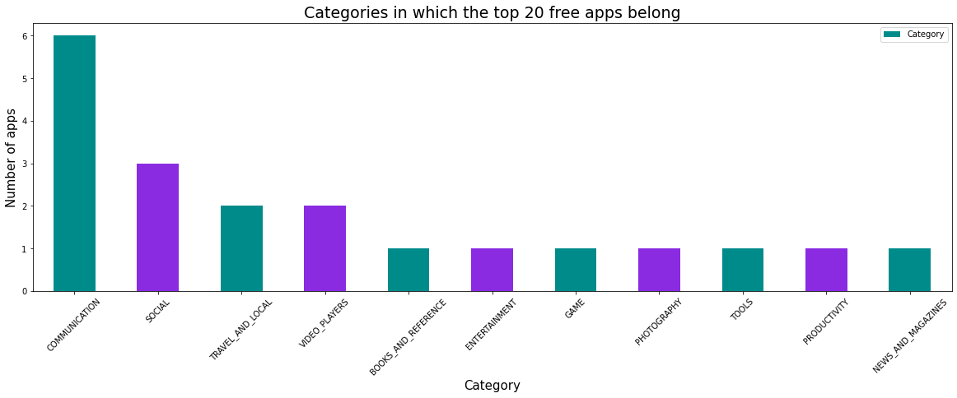
Top Free apps on Google Playstore
In this presentation we found that categories wise top 20 free apps in the play store. Communication category apps are mostly free in the google play store.

Slide 15
SUMMARY ANALYSIS
In this project we analyzing play store applications, we have worked on several parameters which would help any organization to do well in launching their apps on the play store.
1. Percentage of free apps = ~92%
2. In content category ~82% app from Everyone section.
Most of the apps are Free, so focusing on free app is more important.
3. Family, Game and Tools are top three categories having 1832, 959 and 827 app count.
4. As per percentage of App in each category is Family, Game and Tools 18.97%, 9.93% & 8.56% .
5. Tops 3 apps which having rating 4.3,4.4,4.5 respectively.
6. Category with the highest average app installs: Game
7. Subway Surfers have a number one top installed app in the google playstore.

Slide 16
THANK YOU

